Slide 1
CAPDIW Training & Consulting
Brand Identity Design

Slide 2
Concept 1

Slide 3

The thought:
Taking inspiration from symbols used in coding
Creating an artistic expression of the symbol
</>

Slide 4
Expression of letters from the brand name within the logo symbol
CAPDIW

Slide 5

Expression of letters from the brand name within the logo symbol
CAPDIW

Slide 6

Expression of letters from the brand name within the logo symbol
CAPDIW

Slide 7

Final Logo

Slide 8



Stationery

Slide 9


Slide 10
Concept 2

Slide 11

Design inspiration:
Infinity symbol
Thought: A coder has the skills to create infinite possibilities.

Slide 12

The thought:
Taking inspiration from the infinity symbol
Creating an artistic expression of the symbol

Slide 13
Expression of letters from the brand name within the logo symbol
CAPDIW

Slide 14

Expression of letters from the brand name within the logo symbol
CAPDIW

Slide 15

Expression of letters from the brand name within the logo symbol
CAPDIW

Slide 16

Final Logo

Slide 17



Stationery

Slide 18
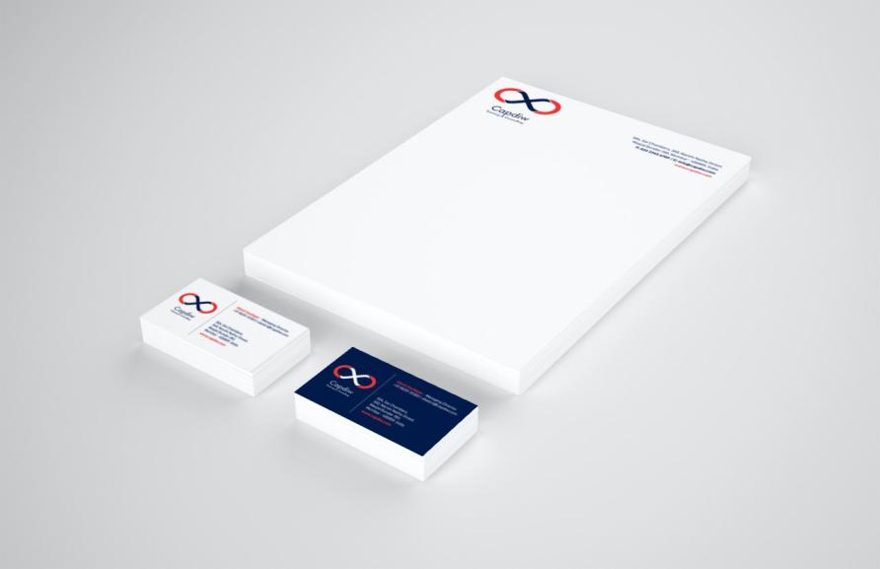

Slide 19
Final Logo

Slide 20
Open for discussion

